Slide 1
Time to Choose Promotion
28-30 Jan 2011

Slide 2
Date: 28-30/01/2011
Times: 10:00-16:00
Store: Truworths Eastgate
Promoter: Carrianne
Date | Times | Total Sales
28 Jan 2011 | 10:00-16:00 | 7480.00
29 Jan 2011 | 10:00-16:00 | 8330.00
30 Jan 2011 | 11:00-15:00 | 4080.00
Total: |  | 19 890.00
Feedback on promotion: At least 1/3 of the customers that came in on Friday did not know that they would be buying in promotion time and receiving gifts.
Saturday went very well and Sunday proofed to be a quiet day across all counters.

Slide 3
Date: 28/01/2011
Times: 10:00-16:00
Store: Truworths Eastgate
Promoter: Carrianne
Date | Product | Price | New Customer | Existing Customer
28 Jan 2011 | Hydra Q Cream | 495.00 |  | Y
 | Hydra Q Cream | 495.00 |  | Y
 | Instant Smooth | 340.00 |  | Y
 | Super Rest Decol. | 875.00 |  | Y
 | Iris Toning Lotion | 230.00 |  | Y
 | Younger Longer | 1100.00 |  | Y
 | Extra Firming Day Cream | 655.00 |  | Y
 | Gentle Foaming Cleanser | 240.00 |  | Y
 | Gloss appeal | 165.00 | Y
 | Everlasting Foundation | 335.00 |  | Y
 | Wonder Perfect | 213.00 | Y
 | Delicious Self Tan | 355.00 | Y
 | Eye Revive | 365.00 |  | Y
 | 1 Step cleanser | 285.00 |  | Y
 | Super Rest Serum | 1050.00 |  | Y
 | Body Concentrate | 240.00 |  | Y
 | Total: | 7480.00

Slide 4
Date: 29/01/2011
Times: 10:00-16:00
Store: Truworths Eastgate
Promoter: Carrianne
Date | Product | Price | New Customer | Existing Customer
29 Jan 2011 | Hydra Q Cream | 495.00 |  | Y
 | Iris Toning Lotion | 230.00 |  | Y
 | Instant Smooth | 340.00 |  | Y
 | Gentle Foaming Cleanser | 240.00 |  | Y
 | Iris Toning Lotion | 230.00 |  | Y
 | Gentle Exfoliater | 330.00 |  | Y
 | Extra Firming Day Cream | 655.00 |  | Y
 | Gentle Foaming Cleanser | 240.00 |  | Y
 | True Radiance 69 | 335.00 |  | Y
 | Gentle Night | 530.00 |  | Y
 | Fix Make up | 260.00 | Y
 | Bright Plus day | 550.00 |  | Y
 | Bright P Serum | 680.00 |  | Y
 | Bright P Serum | 680.00 |  | Y
 | Pure Melt C | 295.00 | Y
 | Moisture Balm | 385.00 | Y
 | Extra Firming eye C | 495.00 |  | Y
 | Bright P Serum | 680.00 |  | Y
 | UV 40 Protection Plus | 450.00 |  | Y
 | Total: | 8330.00

Slide 5
Date: 30/01/2011
Times: 10:00-16:00
Store: Truworths Eastgate
Promoter: Carrianne
Date | Product | Price | New Customer | Existing Customer
30 Jan 2011 | Extra Firming Night | 680.00 |  | Y
 | Relax Body oil | 440.00 |  | Y
 | Everlasting F109 | 335.00 |  | Y
 | Everlasting F109 | 335.00 |  | Y
 | Eye Contour Balm | 370.00 |  | Y
 | Extra Firming Eye Cream | 495.00 |  | Y
 | Multi Active Day | 575.00 | Y
 | Eye Contour Balm | 370.00 | Y
 | Bust Beauty Gel | 480.00 | Y
 | Total: | 4080.00

Slide 6
Date: 28-30/01/2011
Times: 10:00-16:00
Store: Truworths Clearwater
Promoter: Selinah
Date | Times | Total Sales
28 Jan 2011 | 10:00-16:00 | 1918.00
29 Jan 2011 | 10:00-16:00 | 4095.00
30 Jan 2011 | 11:00-15:00 | 1320.00
Total: |  | 7333.00
Feedback on promotion: A Total of 6 customers over the 3 days changed from other houses to Clarins.
Customers commented that it was a good offer and they appreciated the sizes.

Slide 7
Date: 28/01/2011
Times: 10:00-16:00
Store: Truworths Clearwater
Promoter: Selinah
Date | Product | Price | New Customer | Existing Customer
28 Jan 2011 | Super Rest Eye | 700.00 |  | Y
 | Extra firming Foundation | 350.00 | Y
 | Wonder Perfect mascara | 213.00 | Y
 | Extra Firming Day Cream | 655.00 | Y
 | Total: | 1918.00 |  | Y
29 Jan 2011 | Extra Firming Day Cream | 655.00 |  | Y
 | Blush | 320.00 |  | Y
 | Hydra Q day cream | 495.00 | Y
 | Mascara set | 215.00 | Y
 | M/A day cream | 575.00 |  | Y
 | Face oil | 450.00 |  | Y
 | Radiant Mask | 320.00 |  | Y
 | Body shaping suppl | 495.00 | Y
 | Tinted moisturiser | 355.00 |  | Y
 | Mascara set | 215.00 |  | Y
 | Total: | 4095.00 |  | Y
30 Jan 2011 | One step cleanser | 275.00 | Y
 | Treatment oil | 450.00 |  | Y
 | Beauty Flash | 365.00 |  | Y
 | Toner | 230.00 |  | Y
 | Total: | 1320.00 |  | Y

Slide 8
Date: 28-30/01/2011
Times: 10:00-16:00
Store: Truworths Brooklyn
Promoter: Portia
Date | Times | Total Sales
28 Jan 2011 | 10:00-16:00 | 2165.00
29 Jan 2011 | 10:00-16:00 | 2645.00
30 Jan 2011 | 11:00-15:00 | 2380.00
Total: |  | 7190.00
Feedback on promotion: The store had very limited stock, allot of sales were lost, especially with foundation and Powder.

Slide 9
Date: 28/01/2011
Times: 10:00-16:00
Store: Truworths Brooklyn
Promoter: Portia
Date | Product | Price | New Customer | Existing Customer
28 Jan 2011 | Vital Light NIght | 870.00 |  | Y
 | Vital Light Day | 850.00 |  | Y
 | Wonder Perfect mascara | 215.00 |  | Y
 | Toner | 230.00 |  | Y
 | Total: | 2165.00 |  | Y
29 Jan 2011 | Cleansing Cream | 260.00 |  | Y
 | Hand & Nail Cream | 245.00 |  | Y
 | Toner | 260.00 | Y
 | Super Res Day | 1100.00 | Y
 | Cleansing milk | 260.00 |  | Y
 | Cleansing milk | 260.00 |  | Y
 | Cleansing milk | 260.00 |  | Y
 | Total: | 2645.00
30 Jan 2011 | Gentle Foaming Cleanser | 240.00 |  | Y
 | Gentle Foaming Cleanser | 240.00 |  | Y
 | Bright Plus Set | 550.00 |  | Y
 | Gentle Foaming Cleanser | 240.00 | Y
 | Mascara Set | 215.00 |  | Y
 | Instant Eye Make up Remover | 240.00 | Y
 | Extra Firming day | 655.00 |  | Y
 | Total: | 2380.00

Slide 10
Date: 28-30/01/2011
Times: 10:00-16:00
Store: Truworths Sandton
Promoter: Kabelo
Date | Times | Total Sales
28 Jan 2011 | 10:00-16:00 | 2920.00
29 Jan 2011 | 10:00-16:00 | 4149.00
30 Jan 2011 | 11:00-15:00 | 460.00
Total: |  | 7529.00

Slide 11
Date: 28/01/2011
Times: 10:00-16:00
Store: Truworths Sandton
Promoter: Kabelo
Date | Product | Price | New Customer | Existing Customer
28 Jan 2011 | Super restorative day- | 1050.00 |  | Y
 | Gentle foaming cleanser | 240.00 |  | Y
 | Iris toning lotion | 230.00 |  | Y
 | Gereration 6 | 745.00 |  | Y
 | Extra comfort day | 655.00 |  | Y
 | Total: | 2920.00
29 Jan 2011 | Multi active day | 575.00 | Y
 | Multiactive night | 620.00 | Y
 | True radiance foundation | 355.00 |  | Y
 | Wonder volume mascara | 215.00 |  | Y
 | Hydra quench cream | 495.00 | Y
 | Hydra quench serum | 535.00 | Y
 | Super restorative serum | 1354.00 |  | Y
 | Total: | 4149.00
30 Jan 2011 | Toning lotion | 230.00 |  | Y
 | Cleansing milk | 230.00 |  | Y
 | Total: | 460.00

Slide 12
Date: 29/01/2011
Times: 10:00-16:00
Store: Stuttafords Eastgate
Promoter: Jannine
Date | Times | Total Sales
28 Jan 2011 | 10:00-16:00
29 Jan 2011 | 10:00-16:00
30 Jan 2011 | 11:00-15:00
Total:
Feedback on promotion:

Slide 13
Date: 29/01/2011
Times: 10:00-16:00
Store: Stuttafords Eastgate
Promoter: Janinne
Date | Product | Price | New Customer | Existing Customer
29 Jan 2011 | Hydra Quench cream | 495.00 |  | Y
 | Hydra Quench mask | 395.00 |  | Y
 | Body firming cream | 495.00 | Y
 | High Def Body | 460.00 |  | Y
 | Sun Care cream | 310.00 | Y
 | Eye Mono 9 | 195.00 |  | Y
 | Gentle Foaming Cleanser | 240.00 | Y
 | Extra Firming Day | 655.00 | Y
 | Total: | 3245.00

Slide 14
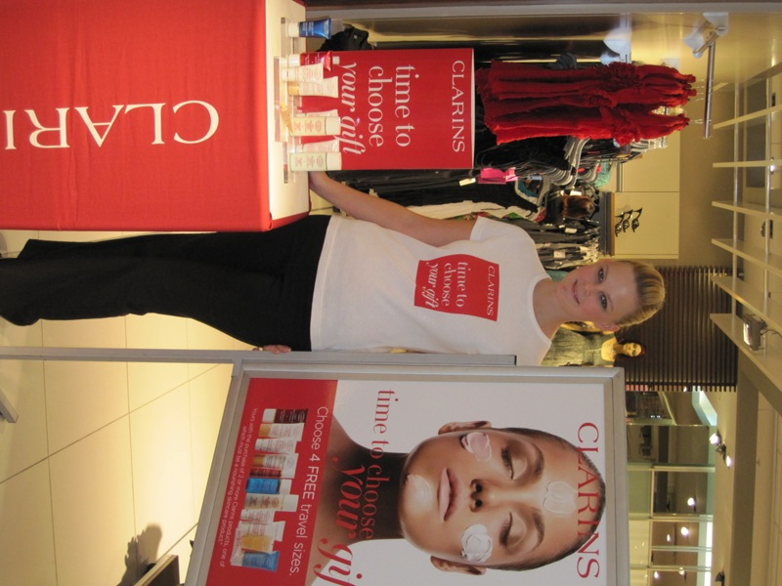
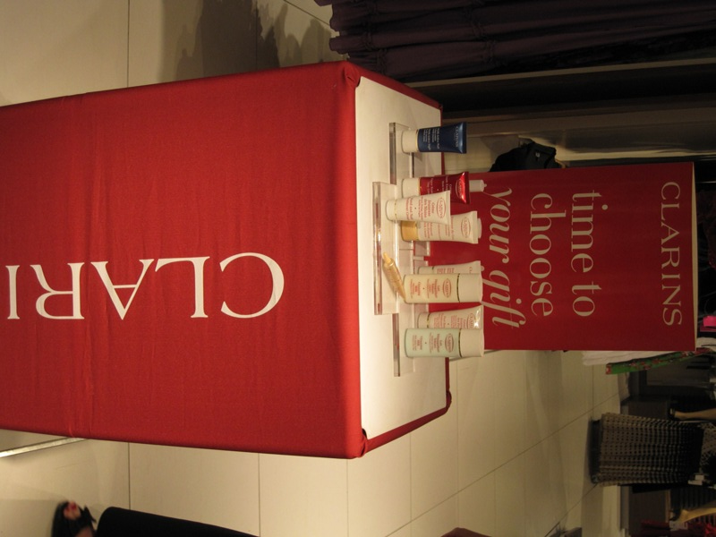
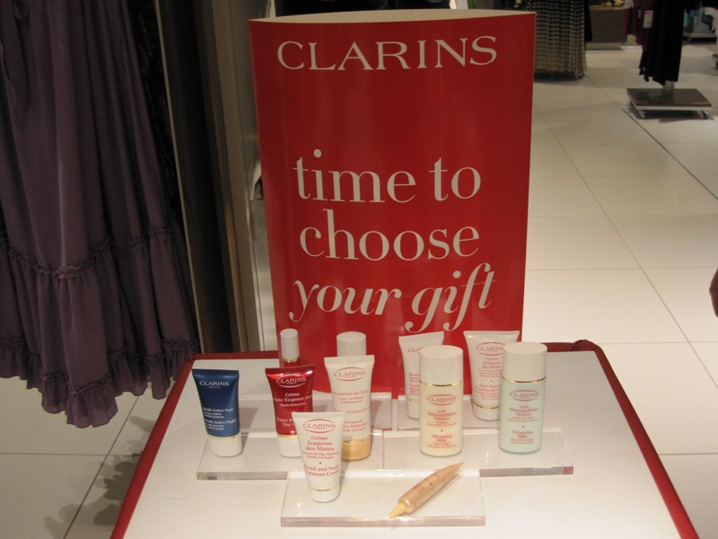

Slide 15
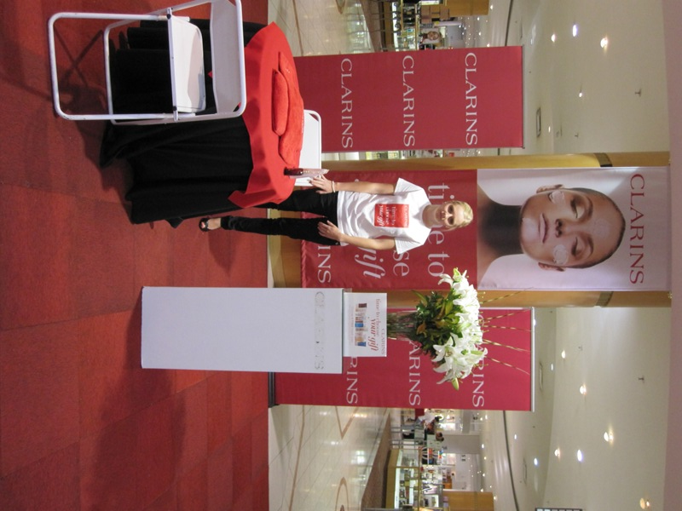
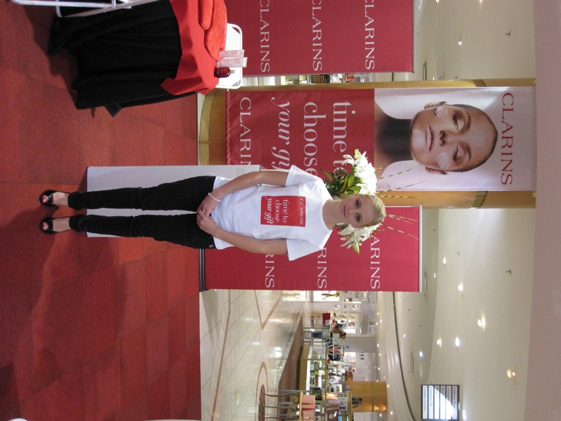
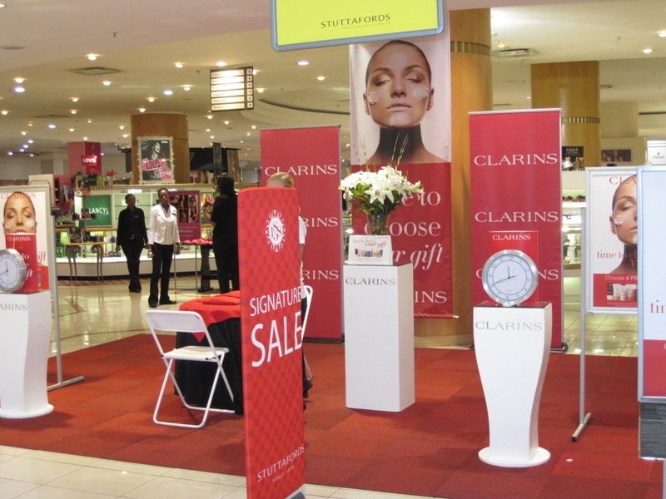

Slide 16
&

